Slide 1
IMS Presentation
By Charlie Reddin

Slide 2
Introduction to me
BA in History at the University of York.
Moved into coding when QA opportunity arose.
Now in week 5 at the training academy as a trainee software developer.

Slide 3
Specification
Using the knowledge gained from the 5 weeks spent in the academy training course, I was tasked with the creation of an Inventory Management System (IMS).
IMS required implementation of knowledge from various topics, such as:

Slide 4
Specification
Databases
Cloud Fundamentals
Programming Fundamentals
Continuous Integration
Automated Testing
Agile & Project Management

Slide 5
Analysis and Design
Kanban Board Utilised
Trello board used to keep track of the workload.
ERD diagram used to design database.
UML diagram used to design the java architecture, which evolved as more was learned.
Risk Assessment used throughout, being updated to keep up with newly-learned technologies.

Slide 6
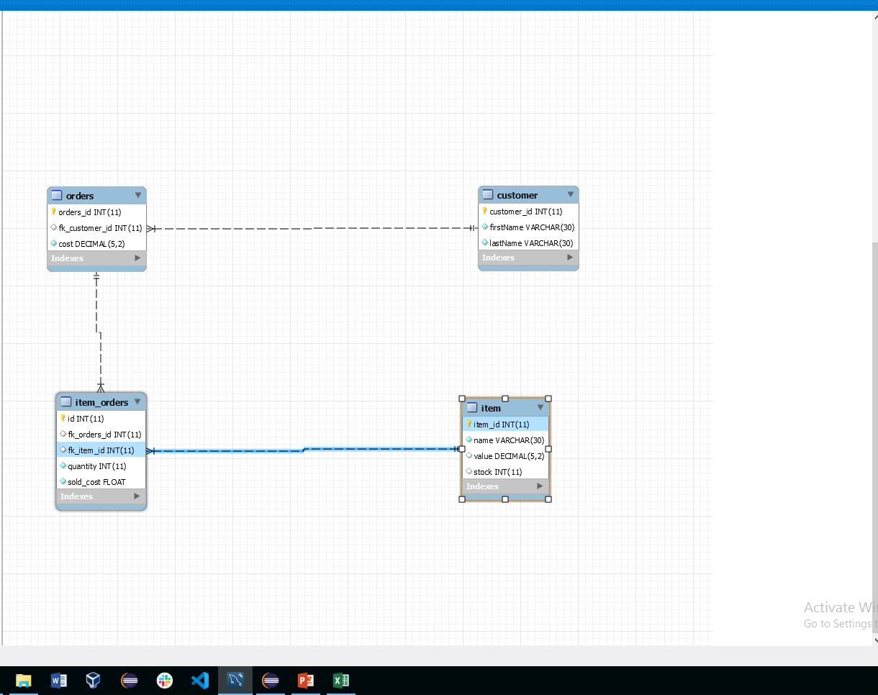
Database ERM Diagram

Slide 7
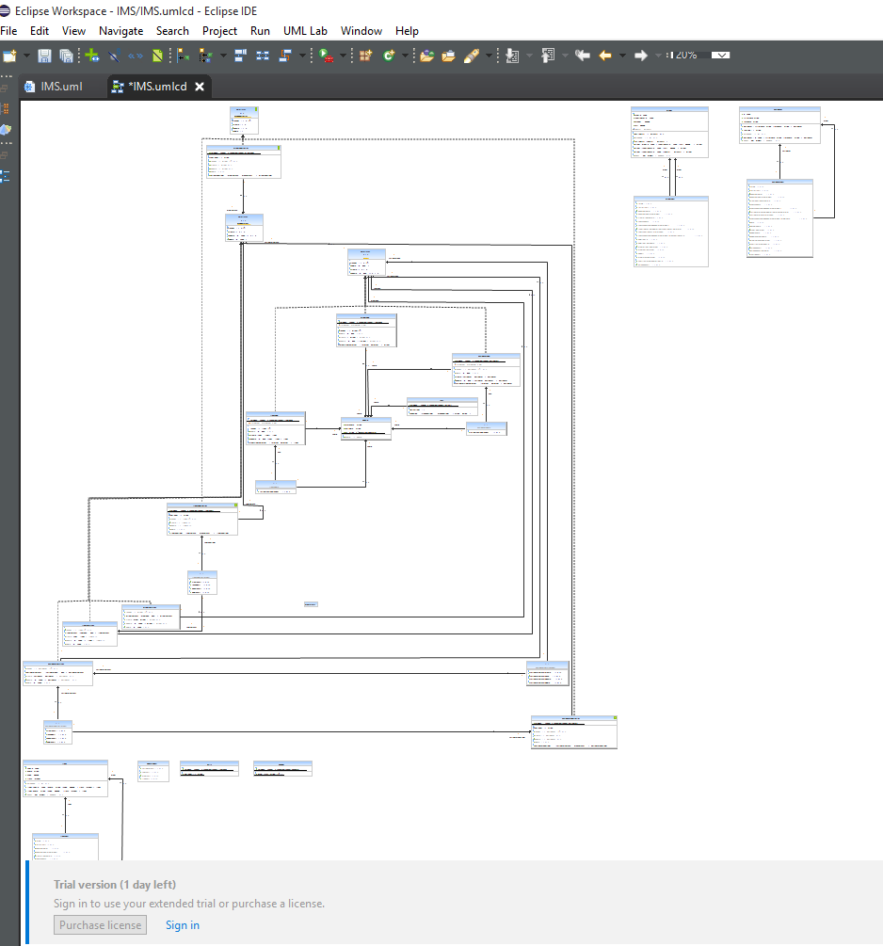
Java Unified Modelling Language Diagram

Slide 8
Coding – SOLID principles
During the design phase of the project, I used OOP and SOLID principles to influence how I designed the classes and packages.
Single Use – DAO only assigned to a single table each.
Open/Closed – used controller interfaces to easily create new controllers without changing their functionality.
Liskov’s Substitution Principle – in controller classes, have a single function that changes function based on what’s given it.
Integration Segregation Principle – interfaces only have functionality that all implementations of said interface use.
Dependency Inversion – in ItemCntroller, I create an item which is then sent down to the ItemDao which then uses it.

Slide 9
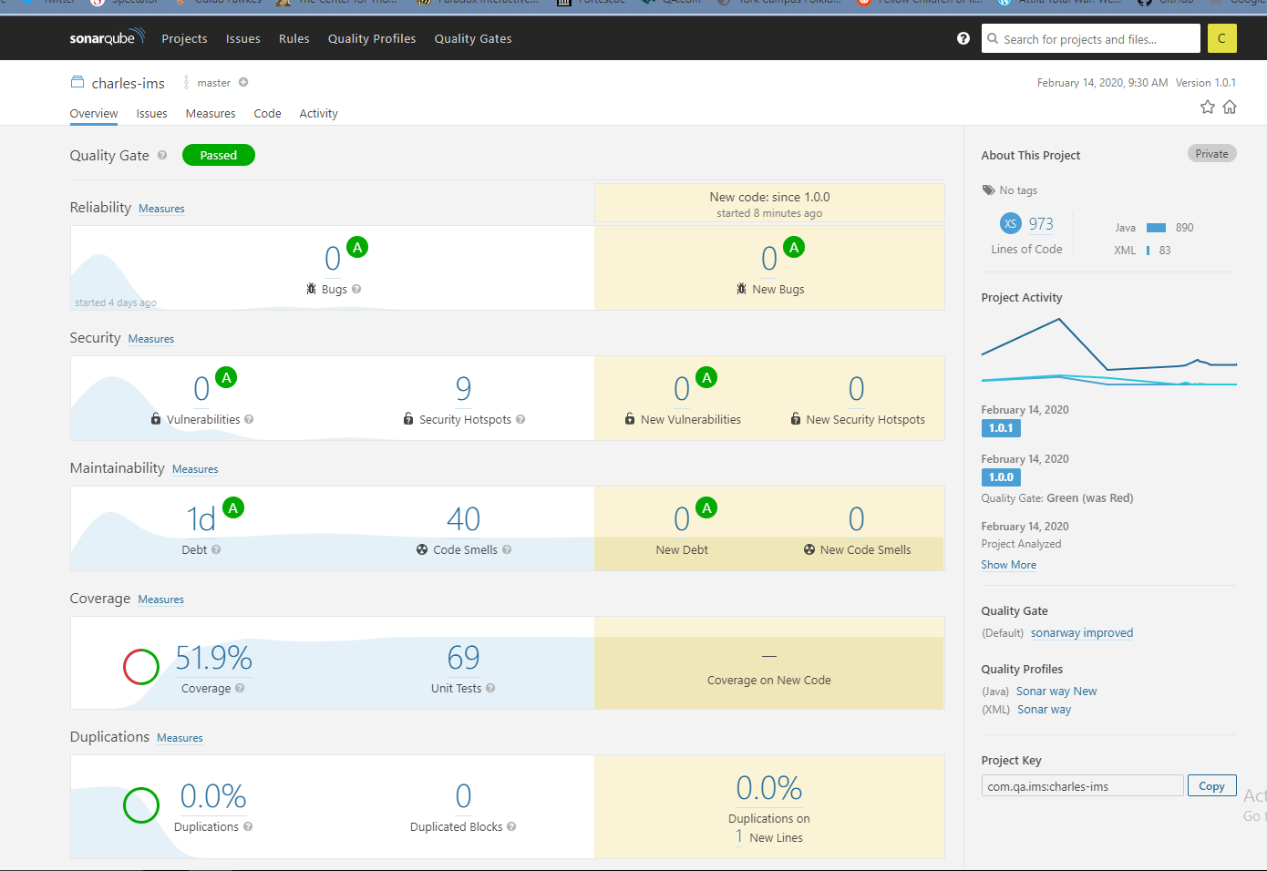
Testing
I used Junit tests to make sure my setters and getters for my database objects were currently functioning.
I also used Mockito to create integration tests which allowed me to test functions that relied on calling other functions.

Slide 10
Automation
I implemented automation into my project firstly through the use of the GCP (Google Cloud Platform) to create a virtual machine instance which hosts the Jenkins CI server.
Jenkins CI server is used to build the IMS whenever there are changes made to the main branch of the GitHub remote repository.
While building, the code is run through SonarQube to check its quality, and make sure that it is of a certain standard.
Assuming it passes, it is deployed to Nexus, which is an Artefact Repository.

Slide 11
Lessons Learned
Over the last 5 weeks, I have learned:
How to code in Java from scratch;
How to install software in a VM;
How to apply DevOps practises to the workplace;
How to run tests and debugging tools;
How to use a CI pipeline to automate development.
If I were to start again, I would apply the following lessons:
I would plan the design of the java out much sooner;
I would ensure that my SQL syntax was tighter;
I would prioritise my tasks more efficiently.

Slide 12
Thanks for listening

